Slide 1
Welcome to Year 1
Diversity, Inclusion, Belonging

Slide 2

Meet the Team
Class Teacher: Miss Ertac
Teaching Assistant: Miss Sheaf
Other adults: Mrs Alcock, Mrs James
PPA Cover: Mr Sadler
(Thursday PM)
Notes:
Mrs Conroy is split between two classes, fortunate to have other adults
PPA/Leadership days – we aim to be consistent but my leadership day does change each half term to cover Mr Horleston – I am also carrying out an NPQH course, to minimise impact on the children I will move my day out of class to ensure the class is being covered by either myself or Mrs De la Croix.

Slide 3
Being ready for school
The gate is open from 8:35am
The whistle is blown at 8:45am
The register is taken straight away – really important that children arrive on time.
Dressed appropriately for the weather (name everything!)
Water bottle brought to school each day
A healthy snack can also be brought in for break time (no crisps or chocolate) – fruit is provided for KS1
Reading book and reading record brought to school each day – please their reading book in their school bag
Notes:
Names on everything

Slide 4
Attend today, Achieve tomorrow!
Missing a few days of school here and there may not seem a big deal, but research shows that it can have a significant impact on children's learning. Children who miss a substantial amount of school fall behind their peers, and struggle to catch up.
Poor attendance often starts at primary school, and children who fall into this pattern are likely to underachieve at secondary school. Pupils who miss between 10 and 20% of school (that’s 19 to 38 days per year) stand only a 35% chance of achieving five or more good GCSEs, compared to 73% of those who miss fewer than 5% of school days.
Friendships can be affected by persistent absence, too: it can be hard for a child who misses lots of school to form relationships with their classmates.

Slide 5
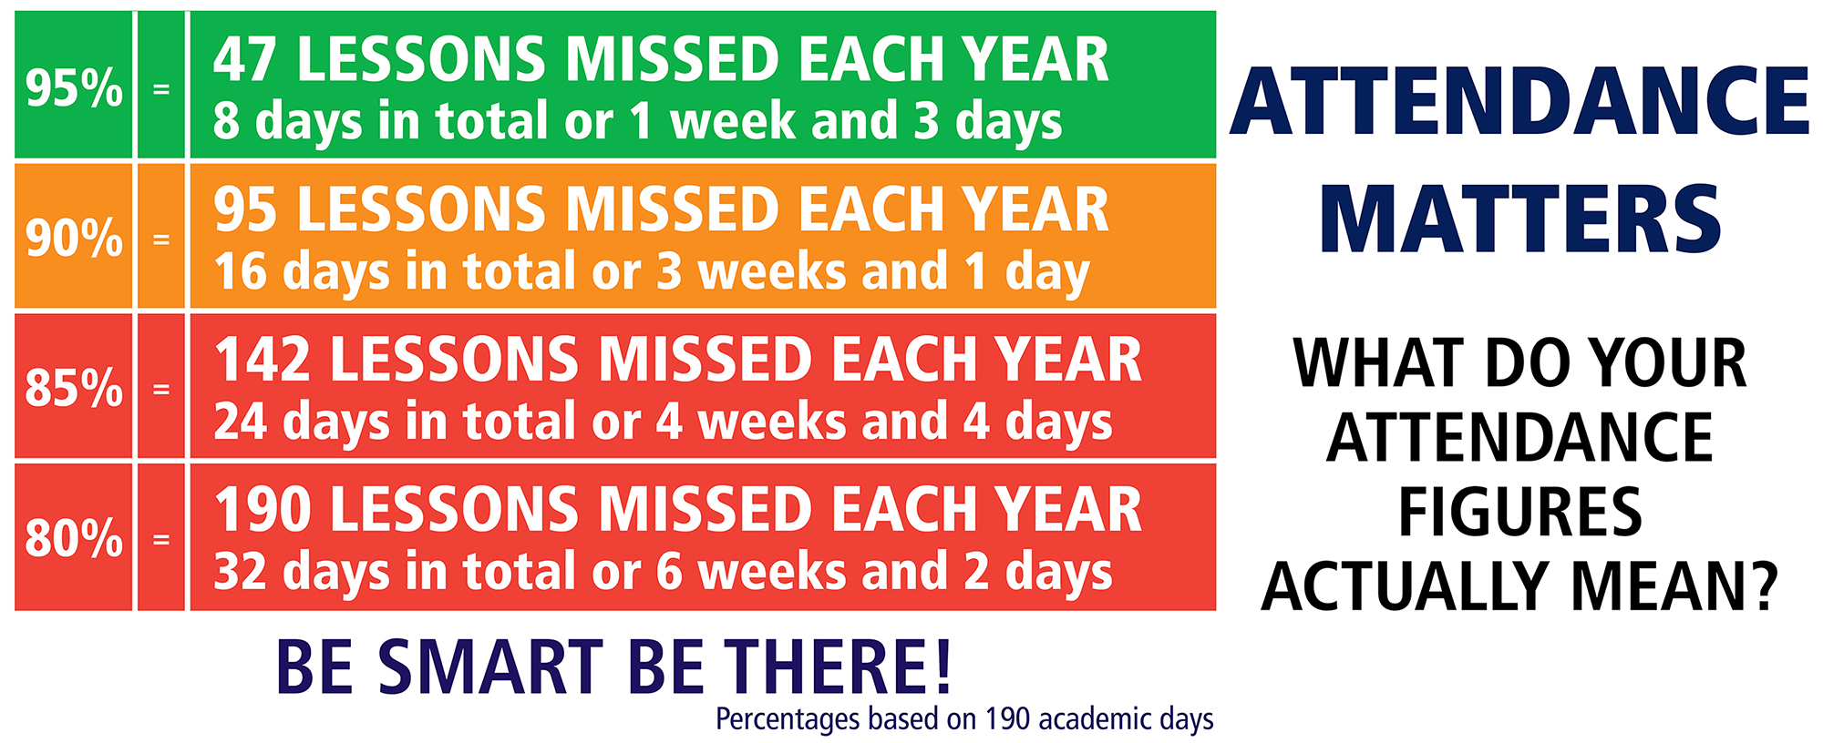

Slide 6
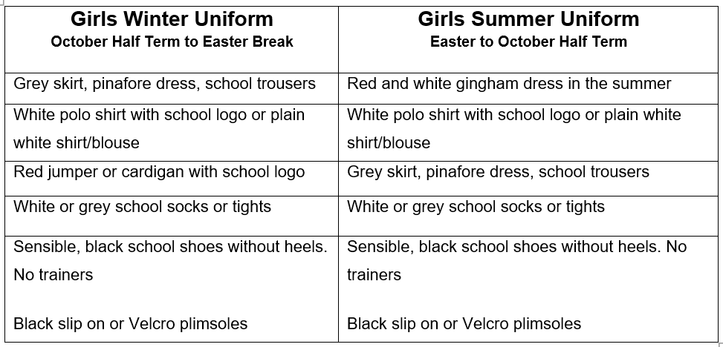
Girl’s Uniform

Slide 7
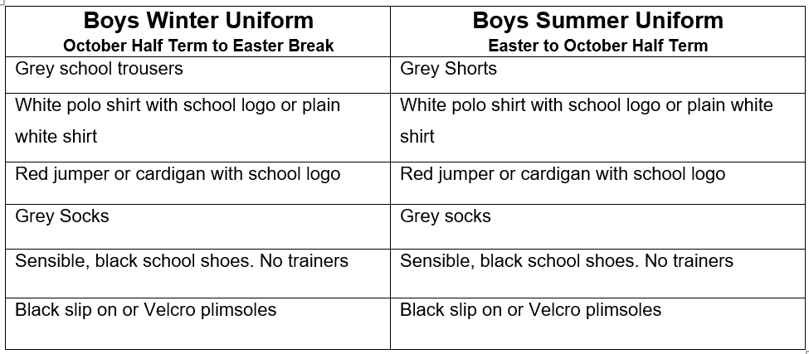
Boy’s Uniform

Slide 8
PE Kit Reminders
PE Kit
Plain white, round neck, t-shirt (school logo optional)
Plain black shorts
Plain black/grey/dark blue joggers
School jumper
Trainers
PE Kit Expectations
It is better for PE Kits to be left in school every day.
It is our preference that PE kits are taken home and washed weekly.
Children will be able to do PE in their school uniform as long as their footwear is deemed safe for the activity being carried out.
If a PE kit isn’t in school, then a quick conversation between the class teacher and parent will take place.
If a PE Kit is missing on a regular basis e.g. 3 weeks in a row, then suitable consequences will be applied.
Year 1 have PE on Wednesdays and Thursdays.
Notes:
Letter home

Slide 9
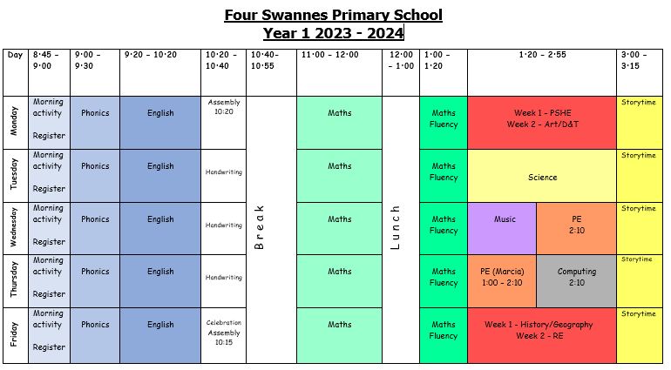
Class Timetable

Slide 10
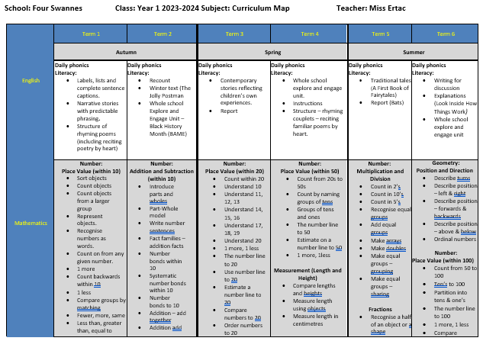
Year 1 Curriculum Map

Slide 11
Statutory Assessment Information
Phonics screening –
Towards the end of the school year, the children will be assessed of their phonics knowledge as part of the statutory phonics screening.
They will be asked to decode words, using their phonics.
This will then help us to support the children in the rest of Key Stage 1 and into Key Stage 2.
Useful websites
https://www.gov.uk/government/publications/key-stage-1-and-2-national-curriculum-tests-information-for-parents

Slide 12
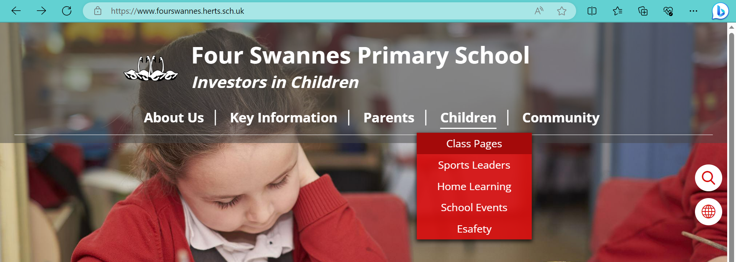
Links to website
Lots of class information can be found on the school website
We regularly update our class page with photos and videos of our work

Slide 13


Slide 14
Communication Reminders
All urgent messages should be communicated to the School Office via telephone or in person on the day.
Feel free to pass a note or a letter to the office in the morning if needed.
All non-urgent messages that you wish to communicate via email should be directed to the School Office on admin@fourswannes.herts.sch.uk – in the subject heading you can state who you wish the email to be forwarded to.
To make an appointment with the class teacher, please speak to the school office or telephone the school office on 01992 763939.

Slide 15
Home-Learning
This Year we will be beginning to send home Home-Learning. Home-Learning will be sent home w/b 18/09/23
Sent home on a Thursday to be returned the following Wednesday.
Home-Learning will be sent home in book bags–
1.Reading practise:- At least 3 times a week. (see next slide)
2. Little Wandle Phonics Sheet:- Children to practice the words based on prior week’s learning
3. Maths Fluency focus:- linked to the maths learning for the previous, current or following week’s work.
Your help in supporting your child with their home-learning is greatly appreciated.
It is important that the children try their best with the activity set. Please let us know if your child is finding it difficult.
Feedback on home-learning is verbal.

Slide 16
Reading at Home
Children will develop their reading skills through a variety of opportunities including independent reading, guided reading and shared reading.
How you can help at home:
  Children should be reading at home 3 times a week
  Aim to read books at least twice, if possible, this will help to increase your child’s fluency and embed any new vocabulary
  Talk about the book and ask questions. Example comprehension questions will be sent out via email (VIPERS)
Staff will aim to change children’s reading books weekly on a Monday/Tuesday (if they have been read).

Slide 17
Interventions that could be used to support your child
Through our ongoing formative assessments, decisions over the weeks ahead will be made as to best help your child to make progress in their learning.
Interventions may include :
Targeted / booster phonic groups
Early morning Writing/ Reading and Maths groups
Use of ‘Lexia’ for reading and phonics skills at home
Social group activities led by familiar and trusted adults
Additional fine-motor skills/ handwriting support
Pre-teaching and guided teaching opportunities
Drawing and Talking
Protective Behaviours
Lego Therapy
Speech and Language support

Slide 18
Year 1 Key learning statements - Reading
Apply phonic knowledge and skills to decode words
Respond with the correct sound to graphemes (letters or groups of letters) for all 40+ phonemes, including, where applicable, alternative sounds for graphemes
Read common exception words, noting unusual correspondences between spelling and sound and where these occur in the word
Read words containing taught GPCs and –s, –es, –ing, –ed, –er and –est endings
Read other words of more than one syllable
Read words with contractions, and understand that the apostrophe represents the missing letter(s)
Read books aloud, accurately that are consistent with their developing phonic knowledge and that do not require them to use other strategies to work out words
Reread these books to build up their fluency and confidence in word reading.

Slide 19
Year 1 Key learning statements - Writing
Sit correctly at a table, holding a pencil comfortably and correctly
Begin to form lower-case letters in the correct direction, starting and finishing in the right place
Form capital letters
Form digits 0-9
Understand which letters belong to which handwriting ‘families’ (i.e. letters that are formed in similar ways) and to practise these
Write sentences by:
Saying out loud what they are going to write about
Composing a sentence orally before writing it
Sequencing sentences to form short narratives
Re-reading what they have written to check that it makes sense

Slide 20
Year 1 Key learning statements - Maths
Count to and across 100, forwards and backwards, beginning with 0 or 1, or from any given number
Count, read and write numbers to 100 in numerals; count in multiples of 2s, 5s and 10s
Given a number, identify 1 more and 1 less
Identify and represent numbers using objects and pictorial representations
Read, write and interpret mathematical statements involving addition (+), subtraction (-) and equals (=) signs
Represent and use number bonds and related subtraction facts within 20
Add and subtract one-digit and two-digit numbers to 20, including 0
Solve one-step problems involving multiplication and division, by calculating the answer using concrete objects, pictorial representations and arrays (with the support of the teacher).

Slide 21
Year 1 Key learning statements – Maths continued
Recognise, find and name a half as 1 of 2 equal parts and quarter as 1 of 4 equal parts of an object, shape or quantity
Compare, describe and solve practical problems for lengths and heights, mass / weight, capacity and volume, time
Recognise and know the value of different denominations of coins and notes
Sequence events in chronological order using language
Recognise and use language relating to dates, including days of the week, weeks, months and years
Tell the time to the hour and half past the hour and draw the hands on a clock face to show these times.
Recognise and name common 2-D and 3-D shapes
Describe position, directions and movements, including whole, half, quarter and three-quarter turns.

Slide 22
Key Dates
Half Term: Monday 23rd October – Friday 27th October
Parent Consultations: Tuesday 7th November/Wednesday 8th November
Occasional Day: Friday 1st December
Nativity Performance: Tuesday 19th December
Last Day of term: Wednesday 20th December

Slide 23
Thank you for joining our Year 1 Workshop
Any Questions?

