Slide 1
Welcome to Year 6
Diversity, Inclusion, Belonging

Slide 2

Meet the Team
Class Teacher: Mrs Amanda Victor
Teaching Assistant: Mrs Dhanjal
Other adults: Mrs. Alcock
Notes:
Mrs Conroy is split between two classes, fortunate to have other adults
PPA/Leadership days – we aim to be consistent but my leadership day does change each half term to cover Mr Horleston – I am also carrying out an NPQH course, to minimise impact on the children I will move my day out of class to ensure the class is being covered by either myself or Mrs De la Croix.

Slide 3
Being ready for school
The gate is open from 8:35am
The whistle is blown at 8:45am
The register is taken straight away – really important that children arrive on time.
Dressed appropriately for the weather (named coats in winter)
Water bottle brought to school each day
A healthy snack can also be brought in for break time (no crisps or chocolate)
Reading book and reading record brought to school each day – please make sure their reading book is in their school bag
Notes:
Names on everything

Slide 4
Attend today, Achieve tomorrow!
Repeatedly missing school can have a significant long-term impact on a child's learning
Pupils who miss between 10 and 20% of school (that’s 19 to 38 days per year) stand only a 35% chance of achieving five or more good GCSEs, compared to 73% of those who miss fewer than 5% of school days.
Friendships can be affected by persistent absence, too: it can be hard for a child who misses lots of school to form relationships with their classmates

Slide 5
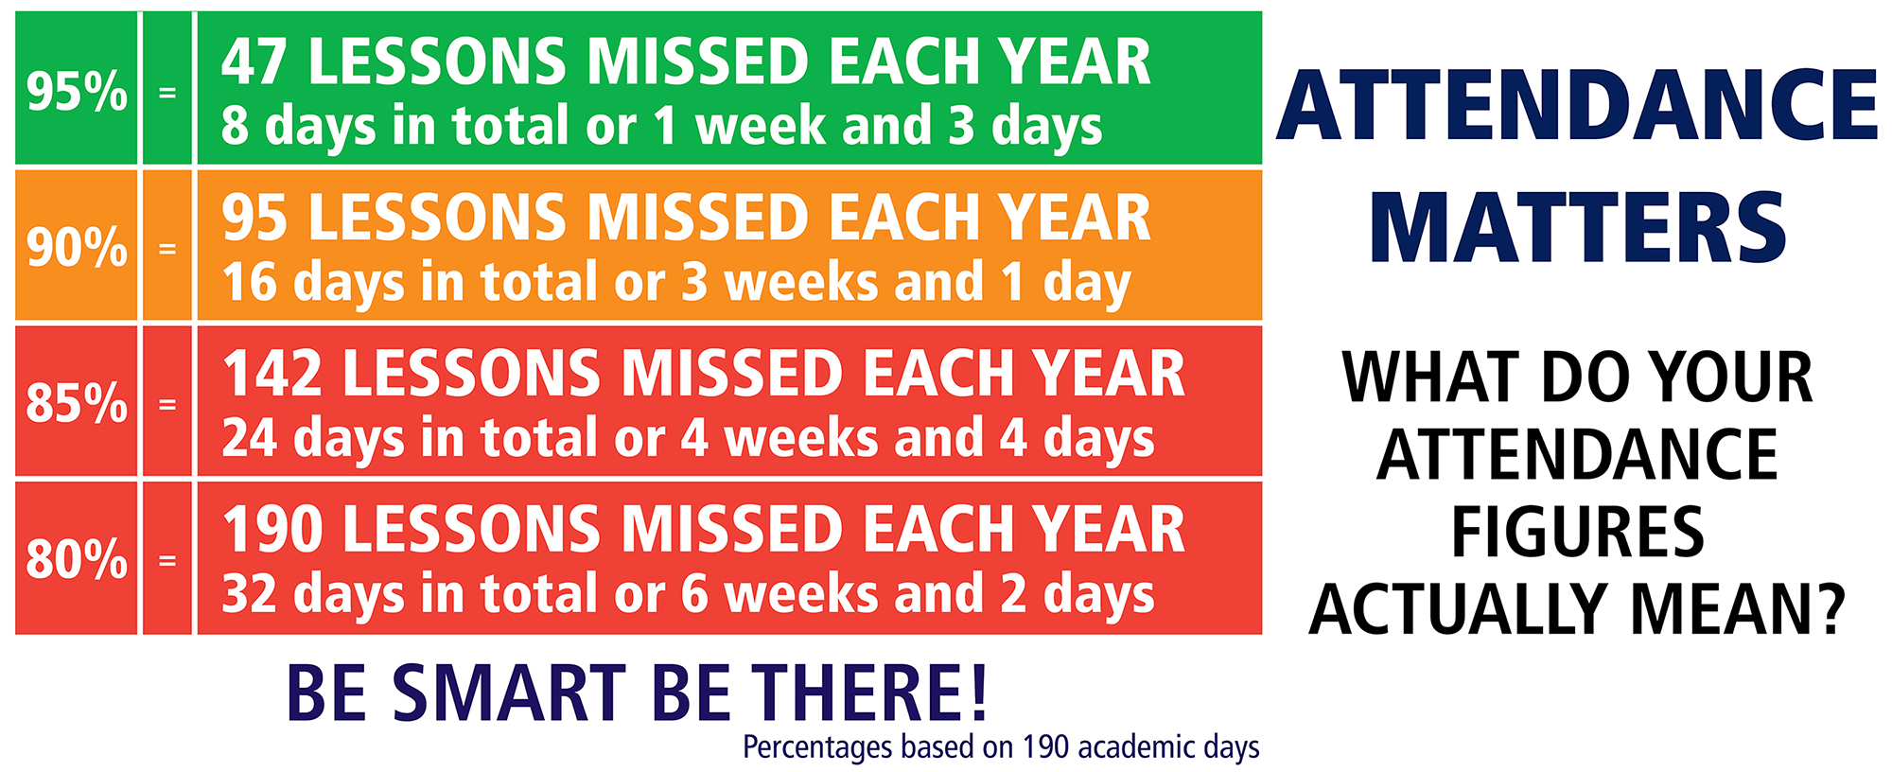

Slide 6
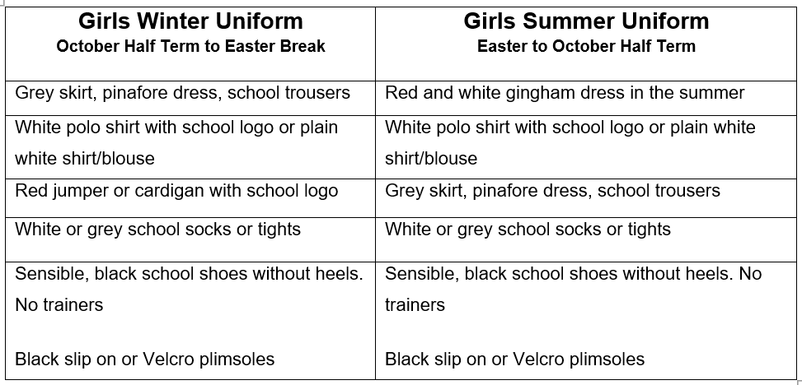
Girls' Uniform

Slide 7
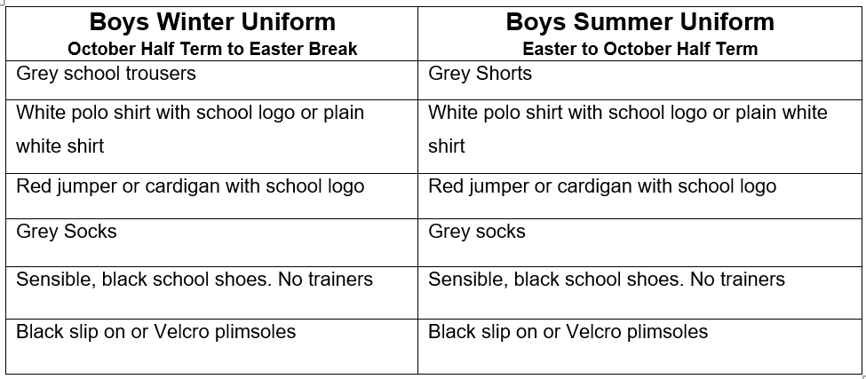
Boys' Uniform

Slide 8
PE Kit Reminders
PE Kit
Plain white, round neck, t-shirt (school logo optional)
Plain black shorts
Plain black/grey/dark blue joggers
School jumper
Trainers
PE Kit Expectations
It is better for PE Kits to be left in school every day.
It is our preference that PE kits are taken home and washed weekly.
Children will be able to do PE in their school uniform as long as their footwear is deemed safe for the activity being carried out.
If a PE kit isn’t in school then a quick conversation between the class teacher and parent will take place.
If a PE Kit is missing on a regular basis e.g. 3 weeks in a row then suitable consequences will be applied.
Year 6 have PE on Tuesdays and Thursdays.
Notes:
Letter home

Slide 9
Day | 8:45- 9:00 | 9:00 - 9:30 | 9:30- 10:15 | 10:15 - 10:40 | 10:40 – 10:55 | 11:00- 12:00 | 12:00- 13:00 | 13:00-15:15
Mon | Spelling morning activity | Maths Fluency | English | Assembly (intervention time if needed) | B | Maths | L | 13:00 – 15:00 Swimming |  |  |  |  |  |  | 15:00- 15:15 Reading
Tue | Grammar morning activity | Guided reading | English |  | R | Maths | U | 13:00 – 13:20 Maths fluency |  |  |  | 13:20 – 14:20 Science | 14:20-15:00 PSHE | 15:00- 15:15 Reading
Wed | Spelling morning activity | Guided reading | English |  | E | Maths | N | 13:00 – 13:20 Maths fluency |  |  |  | 13:20-14:15 Spanish | 14:15 – 15:00 Music | 15:00- 15:15 Reading
Thurs | Grammar morning activity | Spelling test + new spellings | English |  | A | Maths | C | 13:00-14:00 ICT |  |  |  |  | 14:00-15:00 P.E. | 15:00- 15:15 Reading
Fri | Grammar morning activity | Handwriting practice (until 9:15) | English | Assembly (intervention time if needed) | K | Timestables test + Maths | H |  | 13:00 – 13:20 Maths Fluency | 13:20-14:00 RE | 14:00-15:00 Week 1: History Week 2: Art |  |  | 15:00 – 15:15 Reading

Slide 10
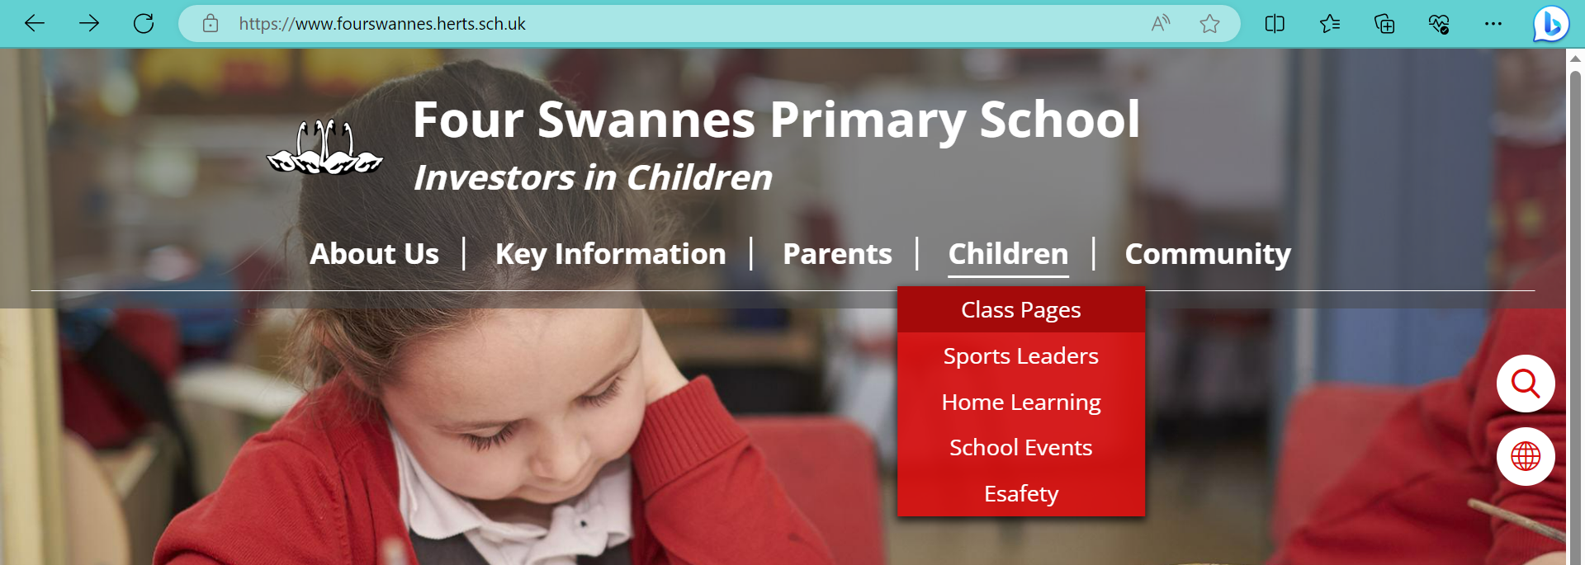
Links to website
Lots of class information can be found on the school website
We regularly update our class page with photos and videos of our work

Slide 11
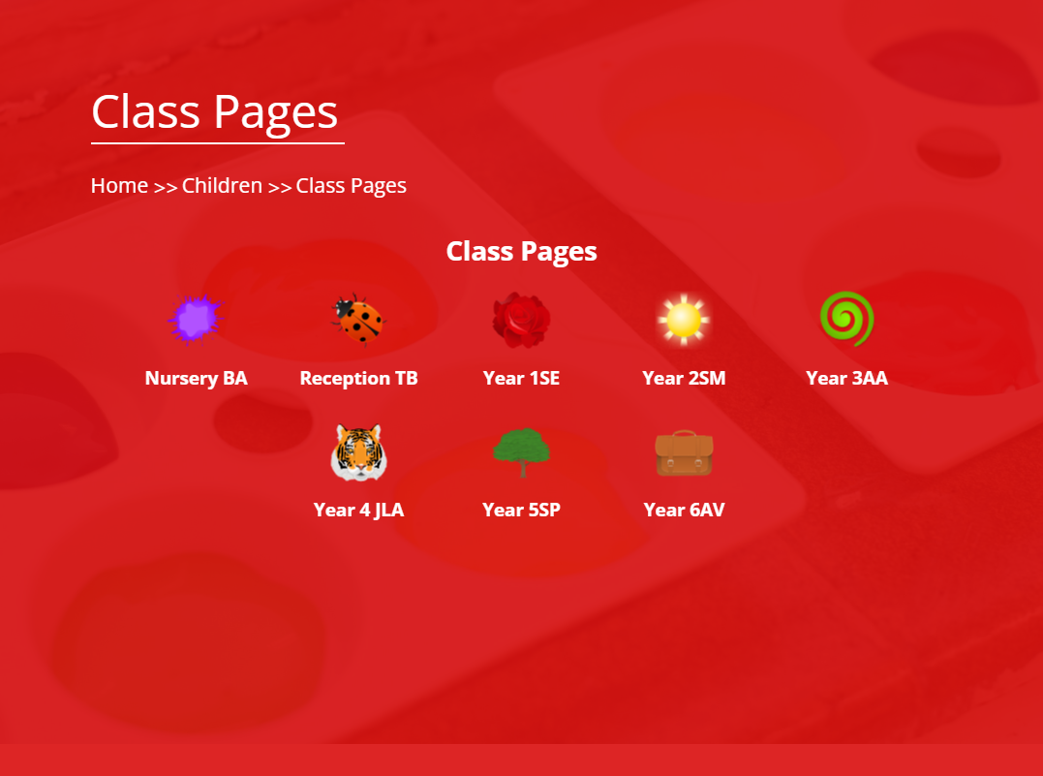

Slide 12
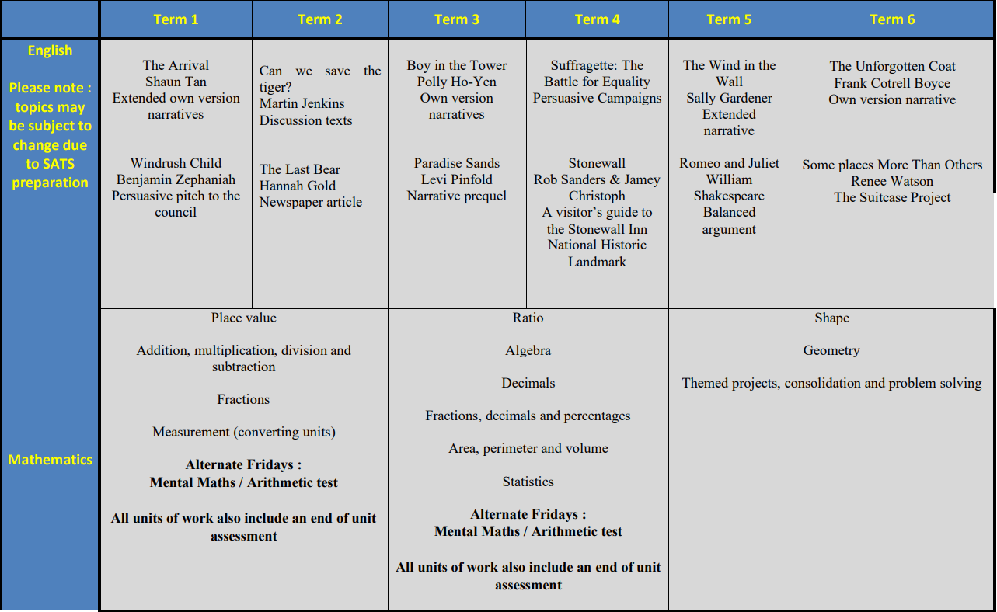
Year Curriculum Map

Slide 13
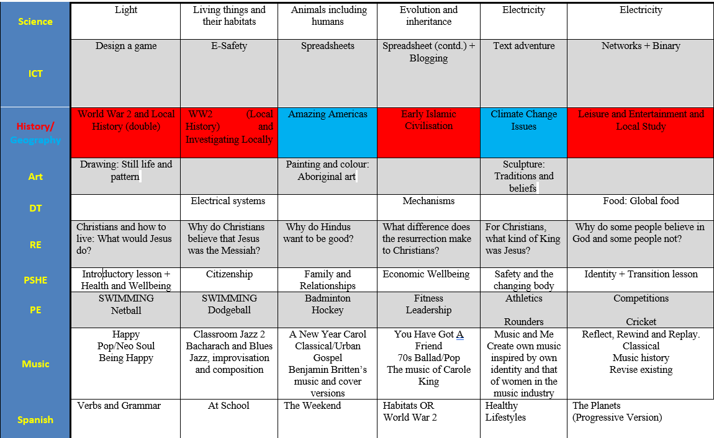

Slide 14
Communication Reminders
All urgent messages should be communicated to the School Office via telephone or in person on the day.
Feel free to pass a note or a letter to the office in the morning if needed.
All non-urgent messages that you wish to communicate via email should be directed to the School Office on admin@fourswannes.herts.sch.uk – in the subject heading you can state who you wish the email to be forwarded to.
To make an appointment with the class teacher, please speak to the school office or telephone the school office on 01992 763939.

Slide 15
Home-Learning
This Year we will continue to send home Home-Learning.
Sent home on a Friday to be returned the following Monday.
Comprehension or Grammar activity
Maths fluency activity
Additionally, we expect your child to :
Practise times tables
Learn spellings (handed out on a Thursday for a test the following Thursday)
Read at least 3 x weekly with an adult
Your help in supporting your child with their home-learning is greatly appreciated.
It is important that the children try their best with the activity set. Please let us know if your child is finding it difficult.
Feedback on home-learning is verbal.

Slide 16
Reading at Home
Children will develop their reading skills through a variety of opportunities including independent reading, guided reading and shared reading.
How you can help at home:
Children should be reading at home 3 times a week
Talk about the book and ask questions.
As soon as a book is finished, please return it so it can be exchanged for a new one

Slide 17
Interventions that could be used to support your child
Through our ongoing formative assessments, decisions over the weeks ahead will be made as to best help your child to make progress in their learning.
Interventions may include :
Targeted / booster phonic groups
Early morning Writing/ Reading and Maths groups
Use of ‘Lexia’ for reading and phonics skills at home
Social group activities led by familiar and trusted adults
Additional fine-motor skills/ handwriting support
Pre-teaching and guided teaching opportunities
Drawing and Talking
Protective Behaviours
Lego Therapy
Speech and Language support

Slide 18
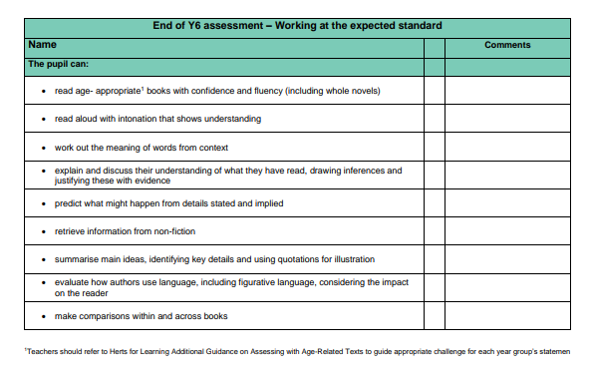
Year 6 Key learning statements - Reading

Slide 19
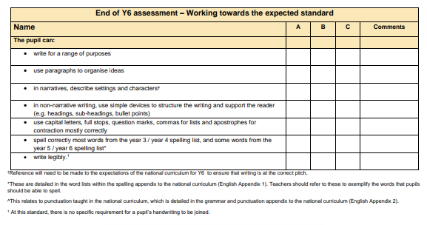
Year 6 Key learning statements - Writing

Slide 20
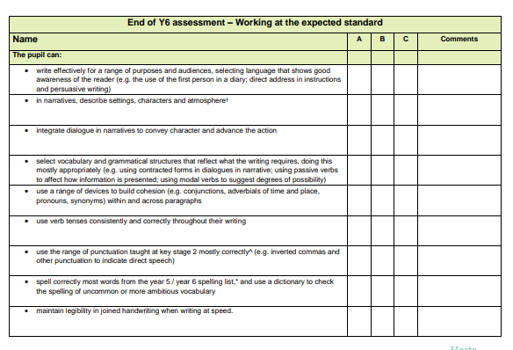

Slide 21
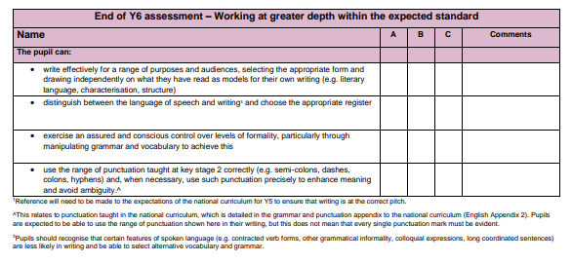

Slide 22
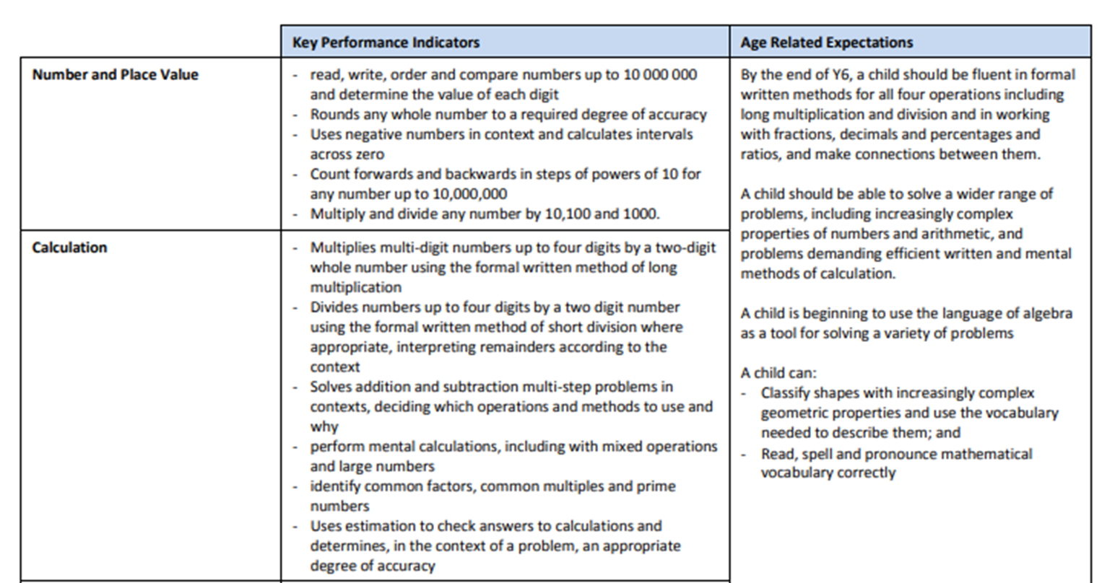
Year 6 Key learning statements - Maths

Slide 23
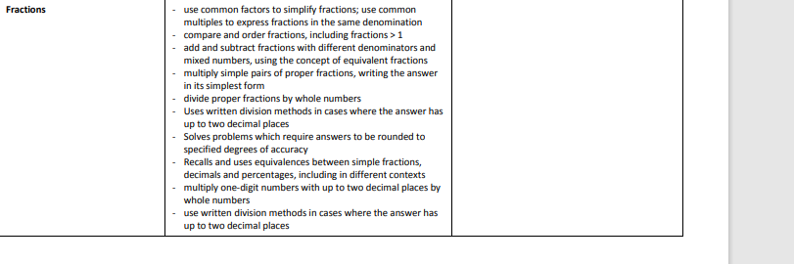
Year 6 Key learning statements – Maths cont’d

Slide 24
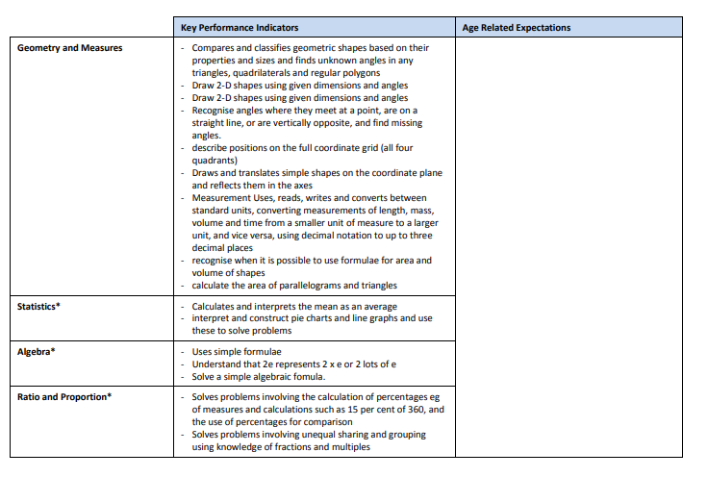

Slide 25
Statutory Assessment Information
Pupils will be taking part in the Statutory End of KS2 Assessments.
This will consist of:
Results are used to support overall teacher judgment. Assessment judgements will be reported at the end of the summer term.
Reading | Maths | Writing
1 Reading test: 50 marks in 60 minutes. | 1 Arithmetic test: 36 questions in 30 minutes. 2 Reasoning tests: approx. 20 questions. in 40 minutes. | 1 Spelling test: 20 words in 20 minutes. 1 SPaG test: 50 questions in 45 minutes.

Slide 26
Key Dates
Half Term: Monday 27th of October 2025 to Friday 31st of October 2025
Parent Consultations: TBC
Occasional Day: 5th of December 2025 - School closed
Last Day of term: 19th December 2025

Slide 27
Thank you for joining our Year 6 Workshop Any Questions?

