Slide 1
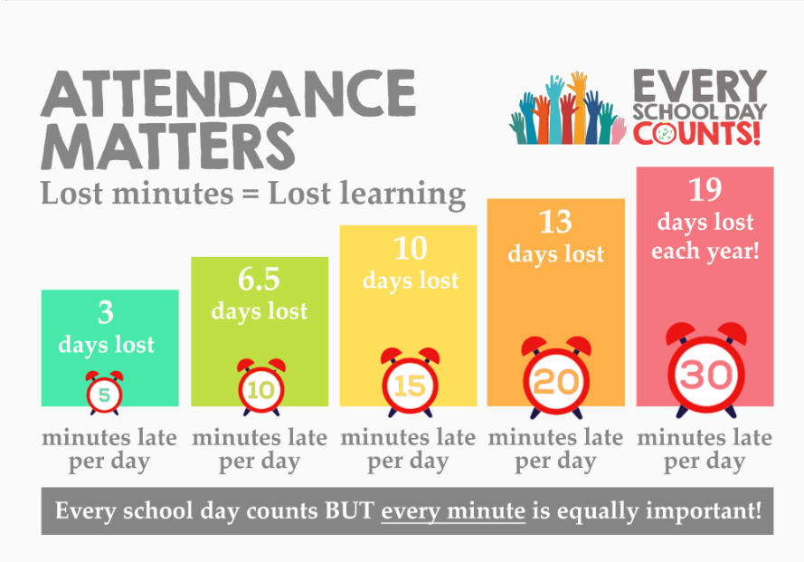


Great attendance matters because every second counts at Four Swannes Primary School.
Absences add up!

