Slide 1
Welcome to Year 3
Diversity, Inclusion, Belonging

Slide 2

Meet the Team
Class Teacher: Miss Ertac
Teaching Assistant:
Mrs Cunningham

Slide 3
Being ready for school
The gate is open from 8:35am
The whistle is blown at 8:45am
The register is taken straight away – very important that children arrive on time.
Dressed appropriately for the weather (named coats in winter)
Water bottle brought to school each day
A healthy snack can also be brought in for break time (no crisps or chocolate)
Reading book and reading record brought to school each day – please make their reading book in their school bag
Notes:
Names on everything

Slide 4
Attend today, Achieve tomorrow!
Repeatedly missing school can have a significant long-term impact on a child's learning
Pupils who miss between 10 and 20% of school (that’s 19 to 38 days per year) stand only a 35% chance of achieving five or more good GCSEs, compared to 73% of those who miss fewer than 5% of school days.
Friendships can be affected by persistent absence, too: it can be hard for a child who misses lots of school to form relationships with their classmates

Slide 5
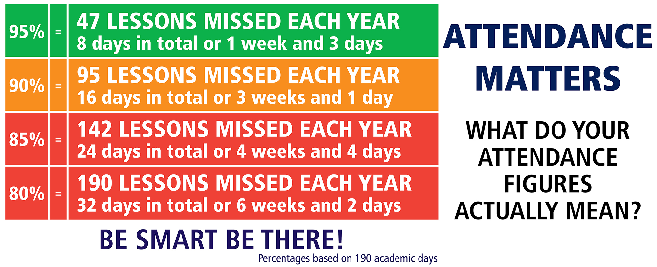

Slide 6
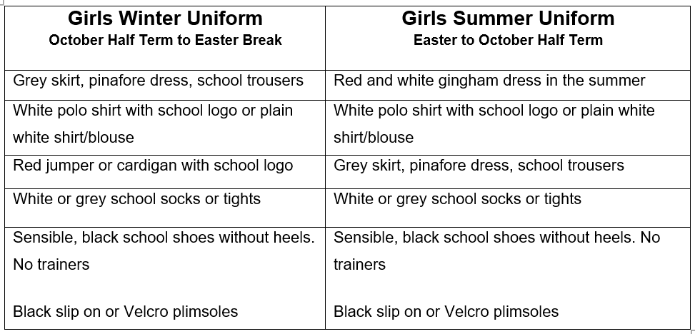
Girls' Uniform

Slide 7
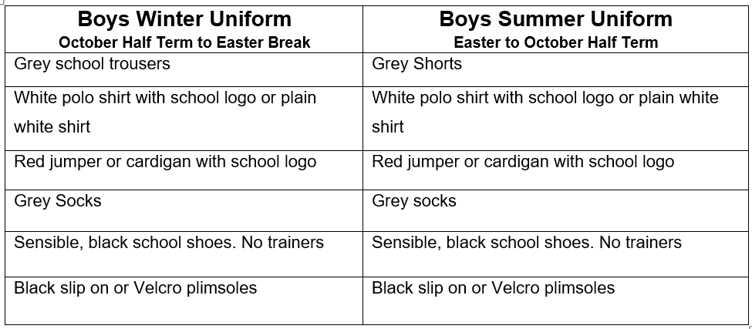
Boys' Uniform

Slide 8
PE Kit Reminders
PE Kit
Plain white, round neck, t-shirt
(school logo optional)
Plain black shorts
Plain black/grey/dark blue joggers
School jumper
Trainers/Plimsolls
PE Kit Expectations
It is better for PE Kits to be left in school every day.
It is our preference that PE kits are taken home and washed weekly.
Children will be able to do PE kit in their school uniform if their footwear is deemed safe for the activity being carried out.
If a PE kit isn’t in school, then a quick conversation between the class teacher and parent will take place.
If a PE Kit is missing on a regular basis e.g. 3 weeks in a row, then suitable consequences will be applied.
Year 3 have PE on
Wednesday and Thursday
Notes:
Letter home

Slide 9
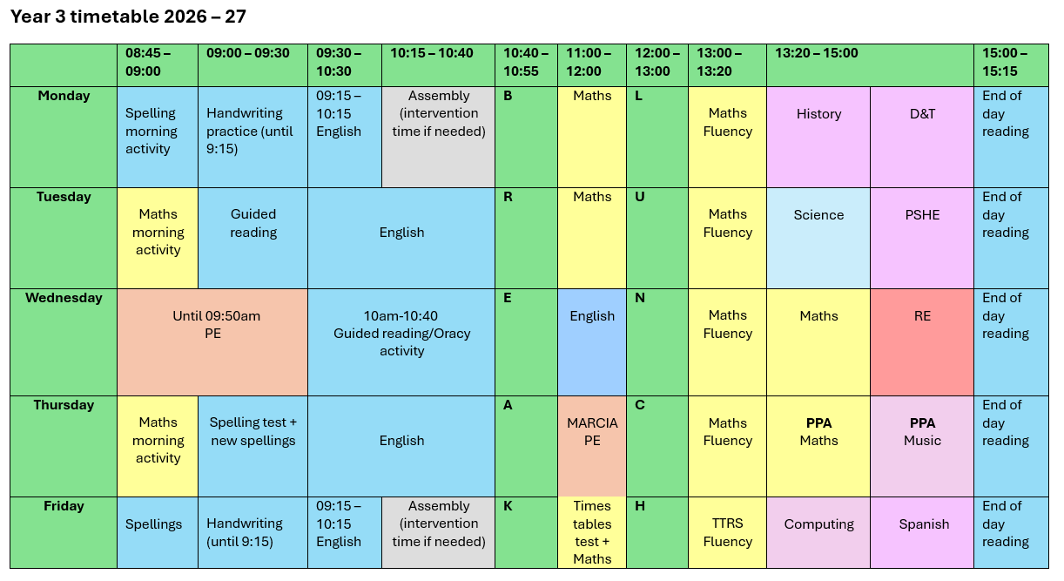
Class Timetable

Slide 10
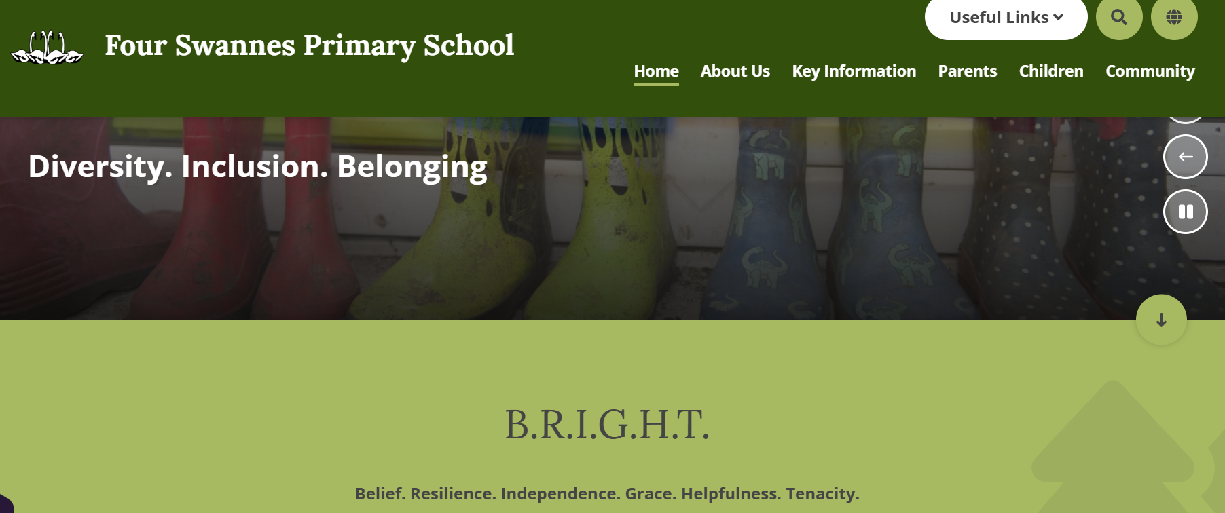
Links to website
Lots of class information can be found on the school website
We regularly update our class page with photos and videos of our work

Slide 11

Class Page:

Slide 12
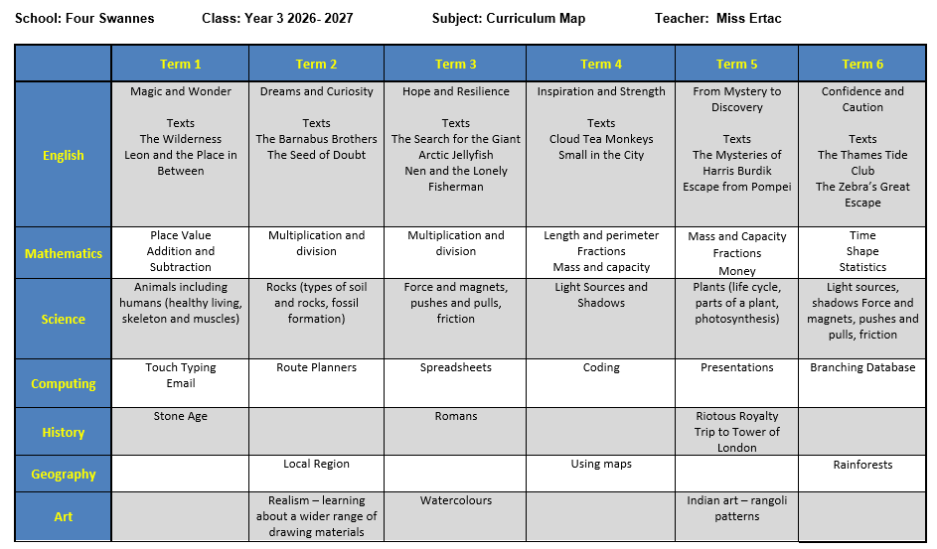
Year 3 Curriculum Map

Slide 13
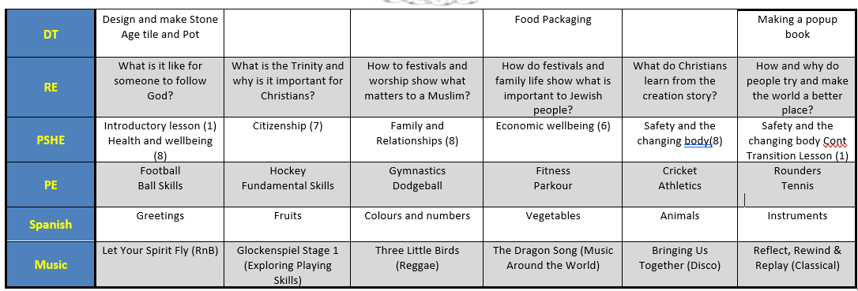
Year 3 Curriculum Map

Slide 14
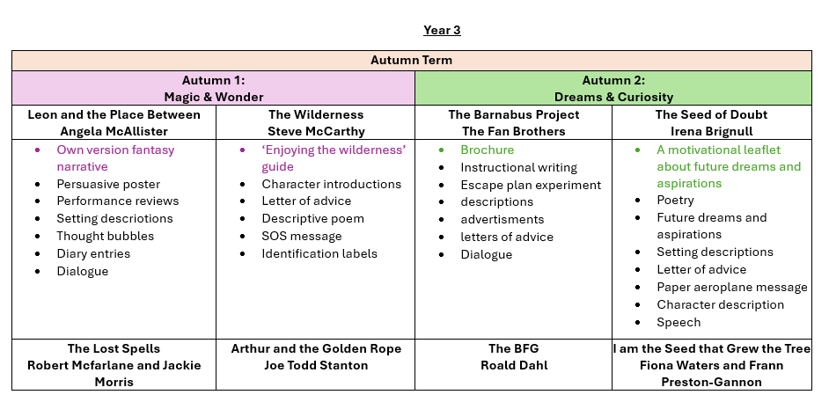
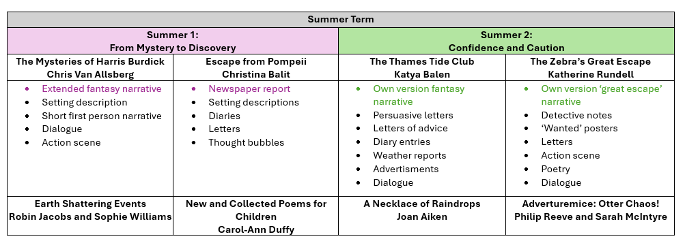
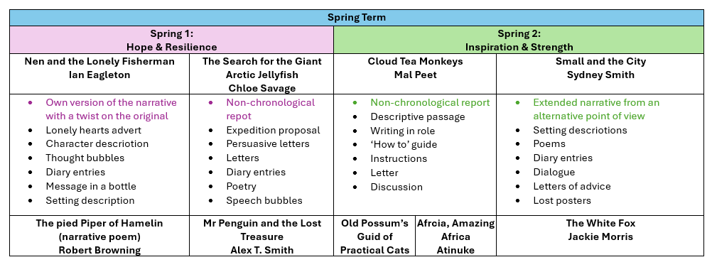

Slide 15
Communication Reminders
All urgent messages should be communicated to the School Office via telephone or in person on the day.
Feel free to pass a note or a letter to the office in the morning if needed.
All non-urgent messages that you wish to communicate via email should be directed to the School Office on admin@fourswannes.herts.sch.uk – in the subject heading you can state who you wish the email to be forwarded to.
To make an appointment with the class teacher, please speak to the school office or telephone the school office on 01992 763939.

Slide 16
Home-Learning
This year we will continue to send home Home-Learning.
Sent home on a Thursday to be returned the following Wednesday
Comprehension or Grammar activity
Maths fluency activity
Additionally, we expect your child to :
Practise timetables tested on a Friday.
Learn spellings (handed out on a Thursday for a test the following Thursday.
Read at least 3 x weekly with an adult.
Your help in supporting your child with their home-learning is greatly appreciated.
It is important that the children try their best with the activity set. Please let us know if your child is finding it difficult.
Feedback on home-learning is verbal.

Slide 17

Reading at Home
Children will develop their reading skills through a variety of opportunities including independent reading, guided reading and shared reading.
How you can help at home:
  Children should be reading at home 3 times a week.
  Talk about the book and ask questions.
  As soon as a book is finished, please return it so it can be exchanged for a new one. These will be changed on a Friday.

Slide 18
Interventions that could be used to support your child
Through our ongoing formative assessments, decisions over the weeks ahead will be made as to best help your child to make progress in their learning.
Interventions may include :
Targeted / booster phonic groups
Early morning Writing/ Reading and Maths groups
Social group activities led by familiar and trusted adults
Additional fine-motor skills/ handwriting support
Pre-teaching and guided teaching opportunities
Drawing and Talking
Protective Behaviours
Speech and Language support

Slide 19
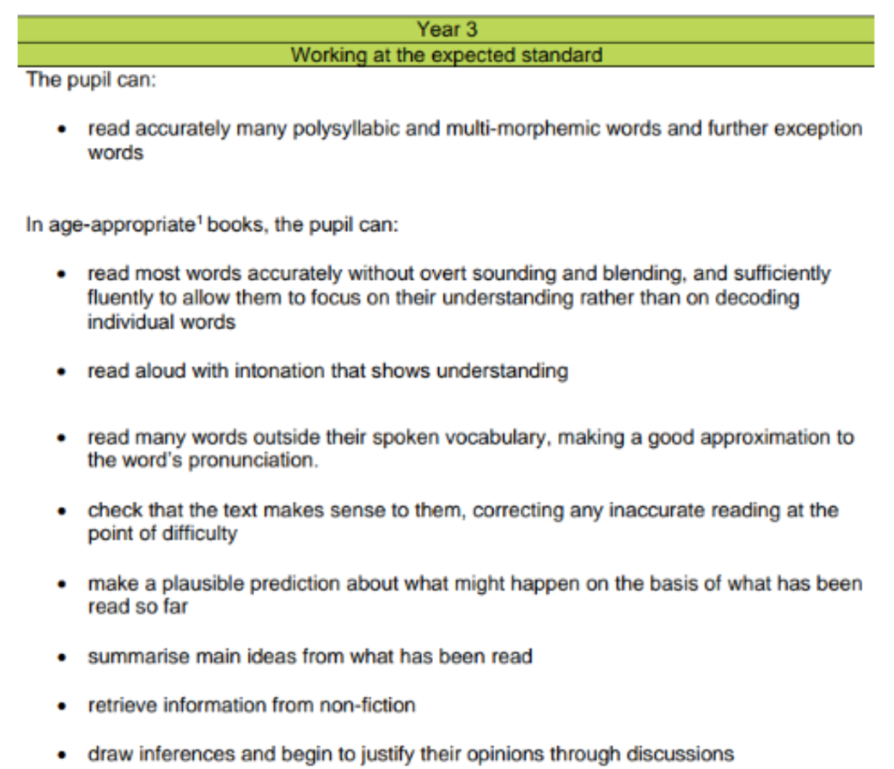
Year 3
Key learning statements - Reading

Slide 20
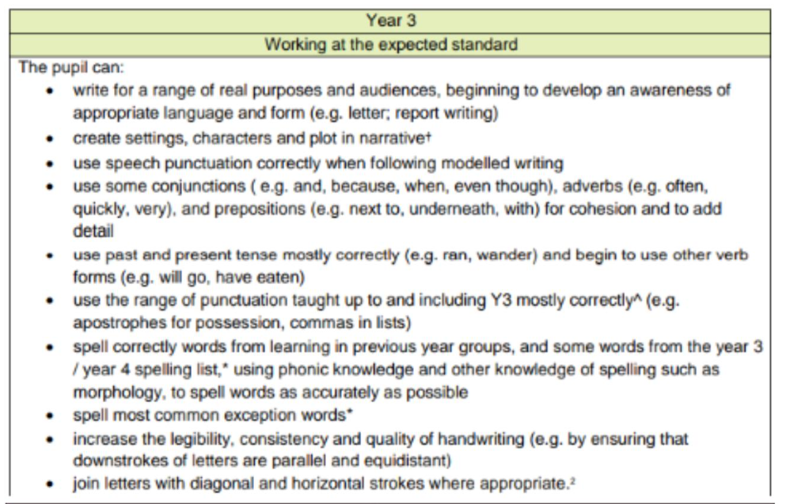
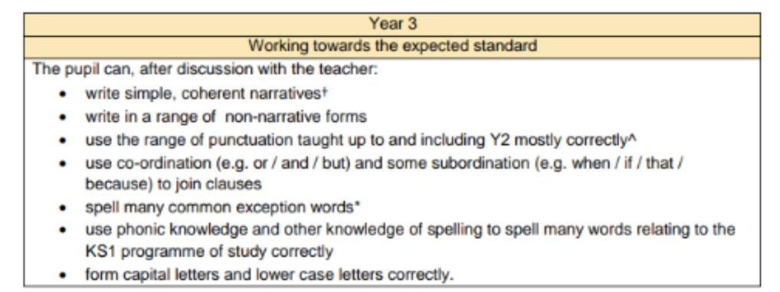
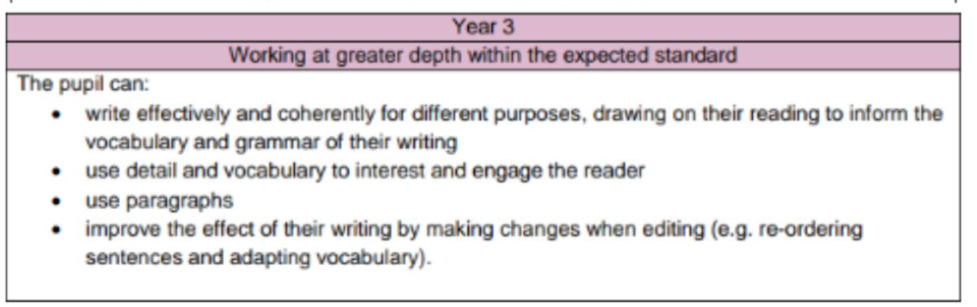
Year Key learning statements - Writing

Slide 21
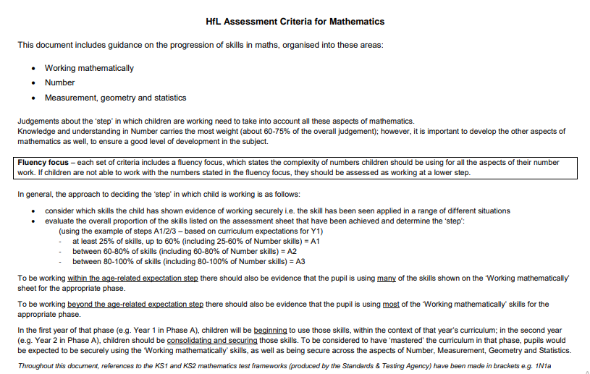
Year 3
Key learning statements - Maths

Slide 22
Key Dates
Half Term: Monday 26th October to 30th October 2026
Year 3 Class Assembly: Friday 6th November 2025
Parent Consultations: TBC
Occasional Day: Friday 27th November 2026
Last Day of Autumn term: Friday 18th December 2026

Slide 23
Thank you for joining our
Year 3 Workshop!
Any Questions?

