Slide 1
Welcome to Year 1
Diversity, Inclusion, Belonging

Slide 2

Meet the Team
Class Teacher: Ms Ertac
Teaching Assistant: Ms Jo and Mrs James
Other adults: Mrs Alcock,
PPA Cover: Ms Jo and Mrs Cunningham
(Thursday PM)
Notes:
Mrs Conroy is split between two classes, fortunate to have other adults
PPA/Leadership days – we aim to be consistent but my leadership day does change each half term to cover Mr Horleston – I am also carrying out an NPQH course, to minimise impact on the children I will move my day out of class to ensure the class is being covered by either myself or Mrs De la Croix.

Slide 3
Being ready for school
The gate is open from 8:35am
The whistle is blown at 8:45am
The register is taken straight away – really important that children arrive on time.
Dressed appropriately for the weather (name everything!)
Water bottle brought to school each day
A healthy snack can also be brought in for break time (no crisps or chocolate) – fruit is provided for KS1
Reading book and reading record brought to school each day – please make sure their reading book is in their school bag.
Notes:
Names on everything

Slide 4
Attend today, Achieve tomorrow!
Missing a few days of school here and there may not seem a big deal, but research shows that it can have a significant impact on children's learning. Children who miss a substantial amount of school fall behind their peers, and struggle to catch up.
Poor attendance often starts at primary school, and children who fall into this pattern are likely to underachieve at secondary school. Pupils who miss between 10 and 20% of school (that’s 19 to 38 days per year) stand only a 35% chance of achieving five or more good GCSEs, compared to 73% of those who miss fewer than 5% of school days.
Friendships can be affected by persistent absence, too: it can be hard for a child who misses lots of school to form relationships with their classmates.

Slide 5
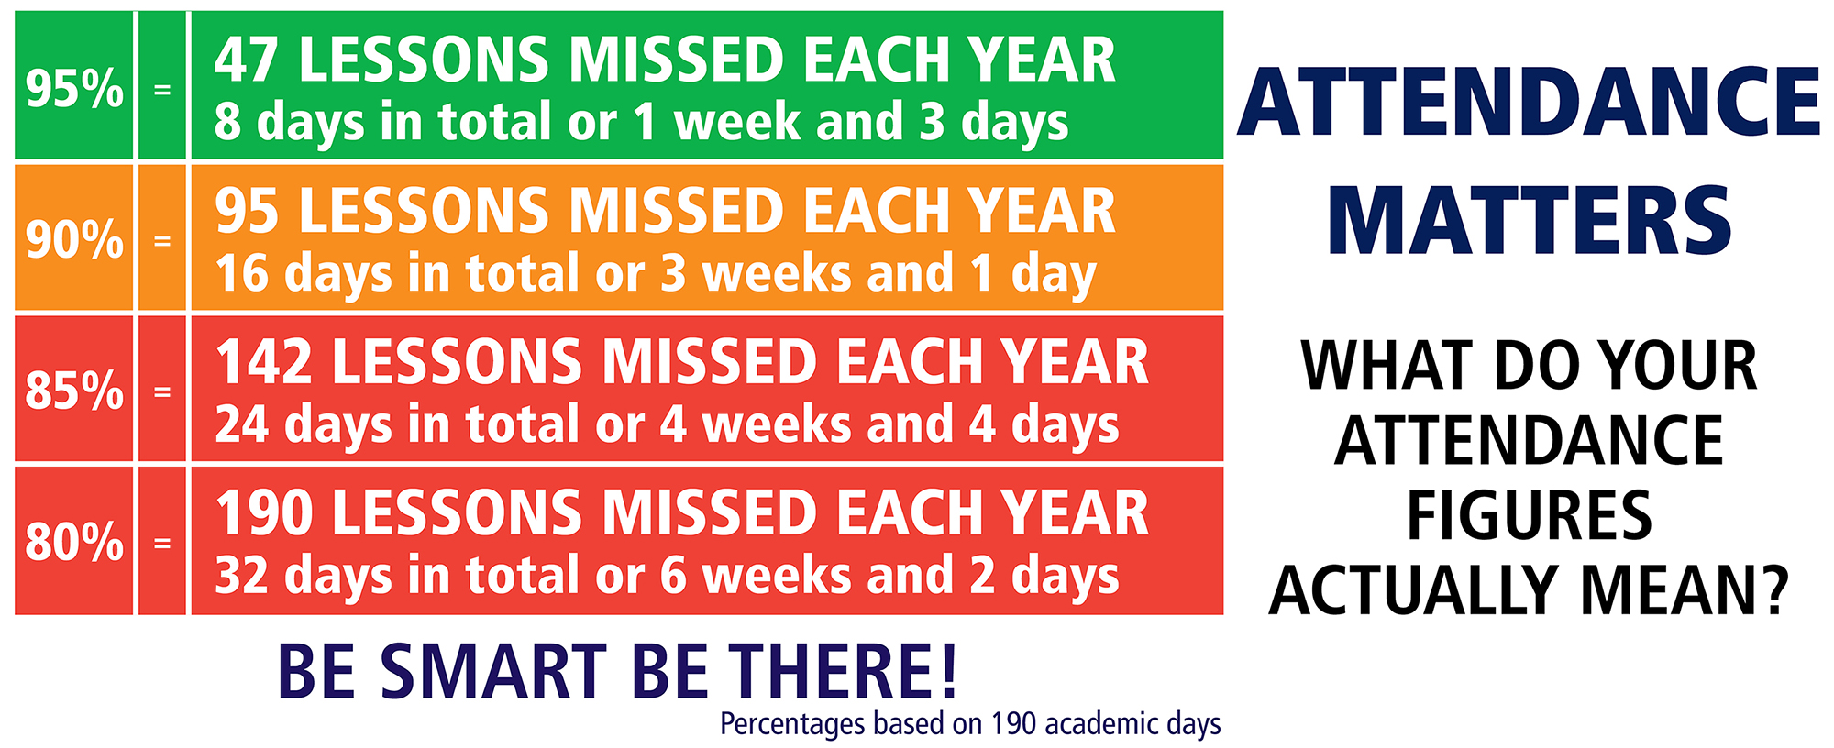

Slide 6
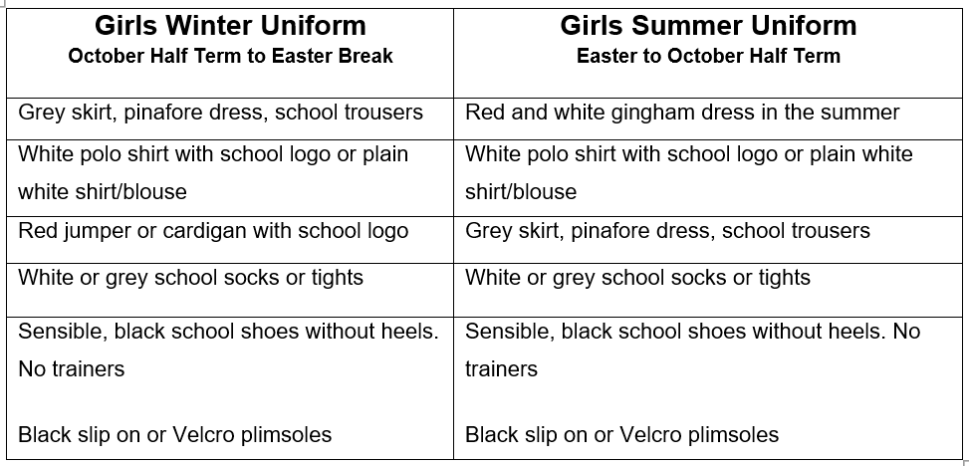
Girl’s Uniform

Slide 7
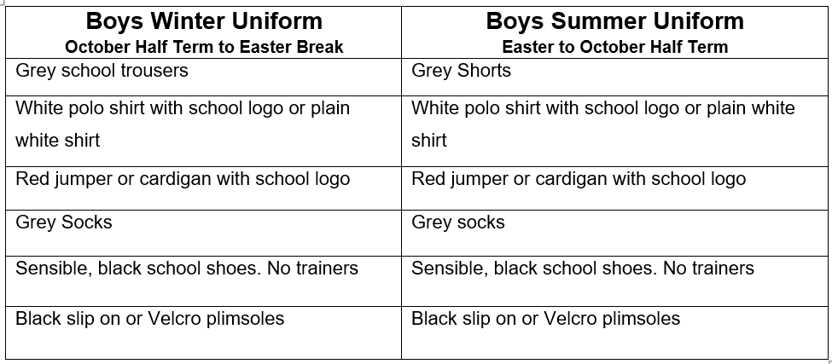
Boy’s Uniform

Slide 8
PE Kit Reminders
PE Kit
Plain white, round neck, t-shirt (school logo optional)
Plain black shorts
Plain black/grey/dark blue joggers
School jumper
Trainers / Plimsoles
PE Kit Expectations
It is better for PE Kits to be left in school every day.
It is our preference that PE kits are taken home and washed weekly.
Children will be able to do PE in their school uniform as long as their footwear is deemed safe for the activity being carried out.
If a PE kit isn’t in school, then a quick conversation between the class teacher and parent will take place.
If a PE Kit is missing on a regular basis e.g. 3 weeks in a row, then suitable consequences will be applied.
Year 1 have PE on Mondays and Fridays.
Notes:
Letter home

Slide 9
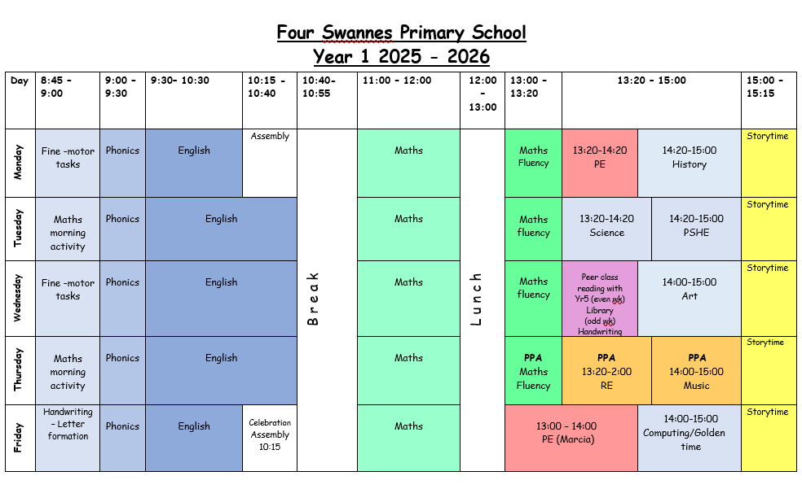
Class Timetable

Slide 10
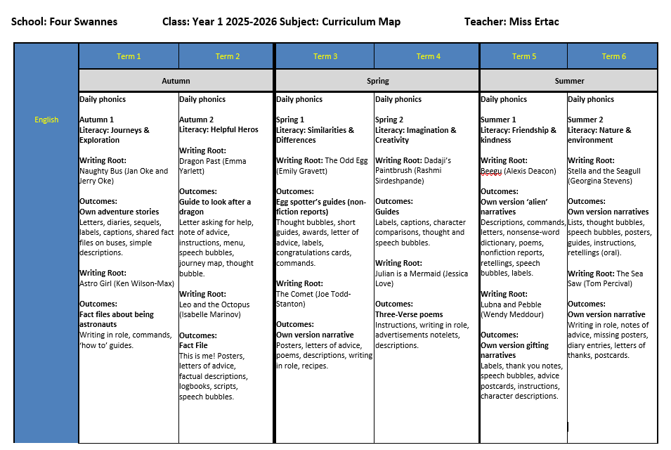
Year 1 Curriculum Map

Slide 11
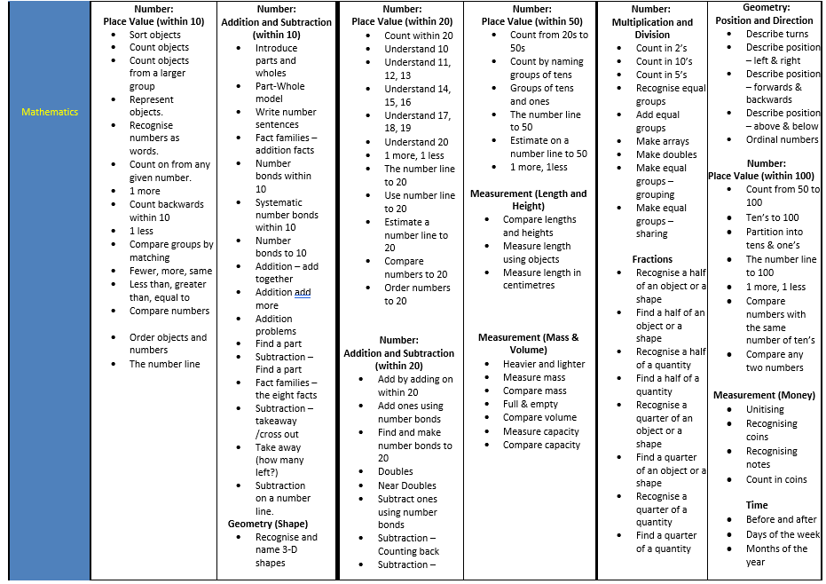
Year 1 Curriculum Map

Slide 12
Statutory Assessment Information
Phonics screening –
Towards the end of the school year, the children will be assessed of their phonics knowledge as part of the statutory phonics screening.
They will be asked to decode words, using their phonics.
This will then help us to support the children in the rest of Key Stage 1 and into Key Stage 2.
There will be a workshop for you to attend nearer to date regarding the assessment.
Useful websites
https://www.gov.uk/government/publications/key-stage-1-and-2-national-curriculum-tests-information-for-parents

Slide 13
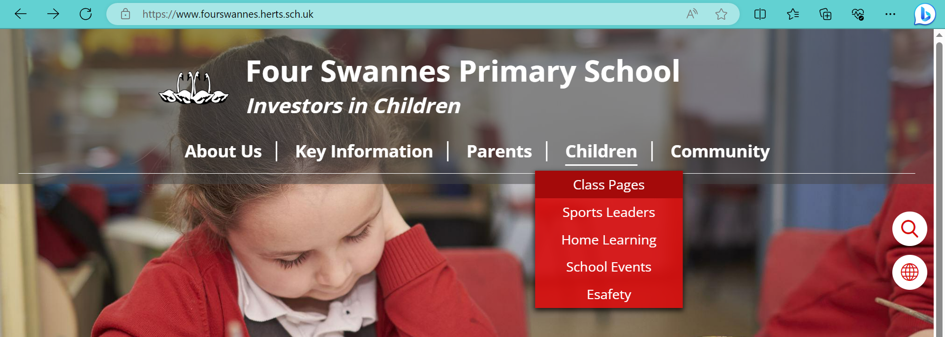
Links to website
Lots of class information can be found on the school website
We regularly update our class page with photos and videos of our work

Slide 14


Slide 15
Communication Reminders
All urgent messages should be communicated to the School Office via telephone or in person on the day.
Feel free to pass a note or a letter to the office in the morning if needed.
All non-urgent messages that you wish to communicate via email should be directed to the School Office on admin@fourswannes.herts.sch.uk – in the subject heading you can state who you wish the email to be forwarded to.
To make an appointment with the class teacher, please speak to the school office or telephone the school office on 01992 763939.

Slide 16
Home-Learning
This Year we will be beginning to send home Home-Learning. Home-Learning will be sent home w/b 8th September 2025
Sent home on a Friday to be returned the following Monday.
Home-Learning will be sent home in book bags weekly –
1.Reading practise/sharing books:- At least 3 times a week. (see next slide)
2. Little Wandle Phonics Sheet:- Children to practice the words based on prior week’s learning
3. Maths:- linked to the maths learning for the previous, current or following week’s work.
Your help in supporting your child with their home-learning is greatly appreciated.
It is important that the children try their best with the activity set. Please let us know if your child is finding it difficult.
Feedback on home-learning is verbal.

Slide 17


Reading at Home
Supporting your child with reading
Although your child will be taught to read at school, you can have a huge impact on their reading journey by continuing their practice at home.
There are two types of reading book that your child may bring home:
A reading practice book. This will be at the correct phonic stage for your child. They should be able to read this fluently and independently.
A sharing book. Your child will not be able to read this on their own. This book is for you both to read and enjoy together.
Library will be held every two weeks

Slide 18
Reading practice book
This book has been carefully matched to your child’s current reading level. If your child is reading it with little help, please don’t worry that it’s too easy – your child needs to develop fluency and confidence in reading.
Listen to them read the book. Remember to give them lots of praise – celebrate their success! If they can’t read a word, read it to them. After they have finished, talk about the book together.
Sharing book
In order to encourage your child to become a lifelong reader, it is important that they learn to read for pleasure. The sharing book is a book they have chosen for you to enjoy together.
Please remember that you shouldn’t expect your child to read this alone. Read it to or with them. Discuss the pictures, enjoy the story, predict what might happen next, use different voices for the characters, explore the facts in a non-fiction book. The main thing is that you have fun!

Slide 19
Interventions that could be used to support your child
Through our ongoing formative assessments, decisions over the weeks ahead will be made as to best help your child to make progress in their learning.
Interventions may include :
Targeted / booster phonic groups
Early morning Writing/ Reading and Maths groups
Social group activities led by familiar and trusted adults
Additional fine-motor skills/ handwriting support
Pre-teaching and guided teaching opportunities
Drawing and Talking
Protective Behaviours
Lego Therapy
Speech and Language support

Slide 20
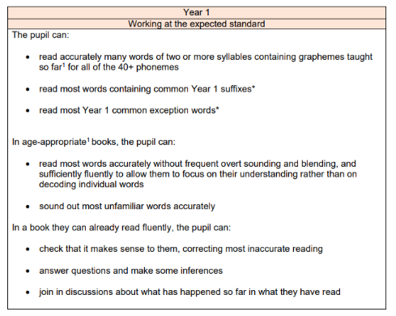
Year 1 Key learning statements - Reading

Slide 21
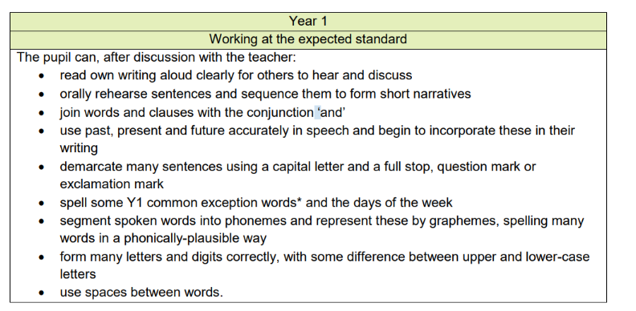
Year 1 Key learning statements - Writing
Sit correctly at a table, holding a pencil comfortably and correctly
Begin to form lower-case letters in the correct direction, starting and finishing in the right place
Form capital letters
Form digits 0-9

Slide 22
Year 1 Key learning statements - Maths
Count to and across 100, forwards and backwards, beginning with 0 or 1, or from any given number
Count, read and write numbers to 100 in numerals; count in multiples of 2s, 5s and 10s
Given a number, identify 1 more and 1 less
Identify and represent numbers using objects and pictorial representations
Read, write and interpret mathematical statements involving addition (+), subtraction (-) and equals (=) signs
Represent and use number bonds and related subtraction facts within 20
Add and subtract one-digit and two-digit numbers to 20, including 0
Solve one-step problems involving multiplication and division, by calculating the answer using concrete objects, pictorial representations and arrays (with the support of the teacher).

Slide 23
Year 1 Key learning statements – Maths continued
Recognise, find and name a half as 1 of 2 equal parts and quarter as 1 of 4 equal parts of an object, shape or quantity
Compare, describe and solve practical problems for lengths and heights, mass / weight, capacity and volume, time
Recognise and know the value of different denominations of coins and notes
Sequence events in chronological order using language
Recognise and use language relating to dates, including days of the week, weeks, months and years
Tell the time to the hour and half past the hour and draw the hands on a clock face to show these times.
Recognise and name common 2-D and 3-D shapes
Describe position, directions and movements, including whole, half, quarter and three-quarter turns.

Slide 24
Key Dates
Half Term:
Monday 27th October – Friday 31st November
Parent Consultations:
Week commencing week 10th November
Math's workshop mornings will be held every term
Occasional Day:
Friday 5th December
Nativity Performance: TBC
Last Day of term:
Friday 19th December early finish 1:30pm

Slide 25
Thank you for joining our Year 1 Workshop
Any Questions?

