Slide 1
Welcome to Year 4
Diversity, Inclusion, Belonging

Slide 2

Meet the Team
Class Teacher: Ms Juanita
Teaching Assistant: Mrs Spears
Notes:
Mrs Conroy is split between two classes, fortunate to have other adults
PPA/Leadership days – we aim to be consistent but my leadership day does change each half term to cover Mr Horleston – I am also carrying out an NPQH course, to minimise impact on the children I will move my day out of class to ensure the class is being covered by either myself or Mrs De la Croix.

Slide 3
Being ready for school
The gate is open from 8:35am
The whistle is blown at 8:45am
The register is taken straight away – really important that children arrive on time.
Dressed appropriately for the weather (named coats in winter)
Water bottle brought to school each day
A healthy snack can also be brought in for break time (no crisps or chocolate)
Reading book and reading record brought to school each day – please make sure their reading book is in their school bag
Notes:
Names on everything

Slide 4
Attend today, Achieve tomorrow!
Repeatedly missing school can have a significant long-term impact on a child's learning
Pupils who miss between 10 and 20% of school (that’s 19 to 38 days per year) stand only a 35% chance of achieving five or more good GCSEs, compared to 73% of those who miss fewer than 5% of school days.
Friendships can be affected by persistent absence, too: it can be hard for a child who misses lots of school to form relationships with their classmates

Slide 5
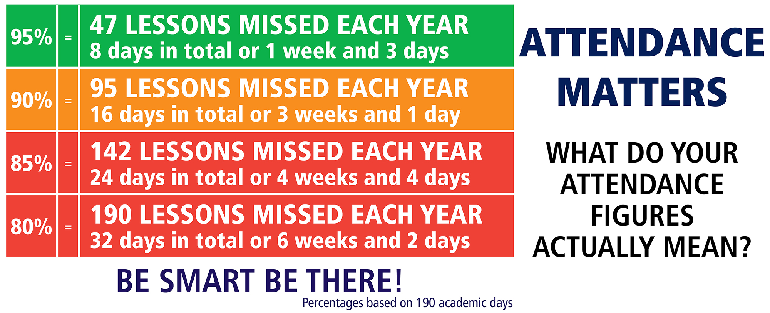

Slide 6
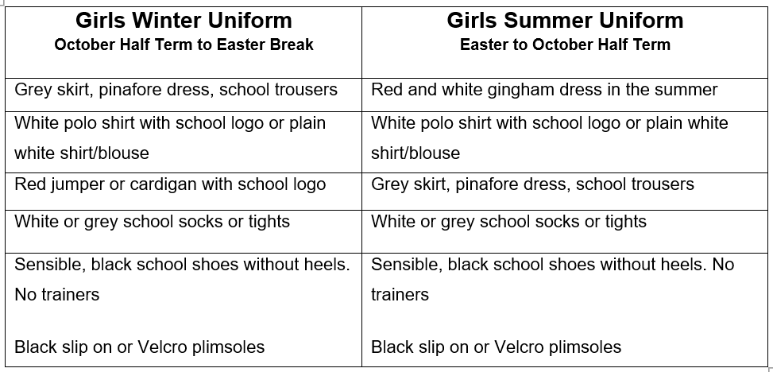
Girls' Uniform

Slide 7
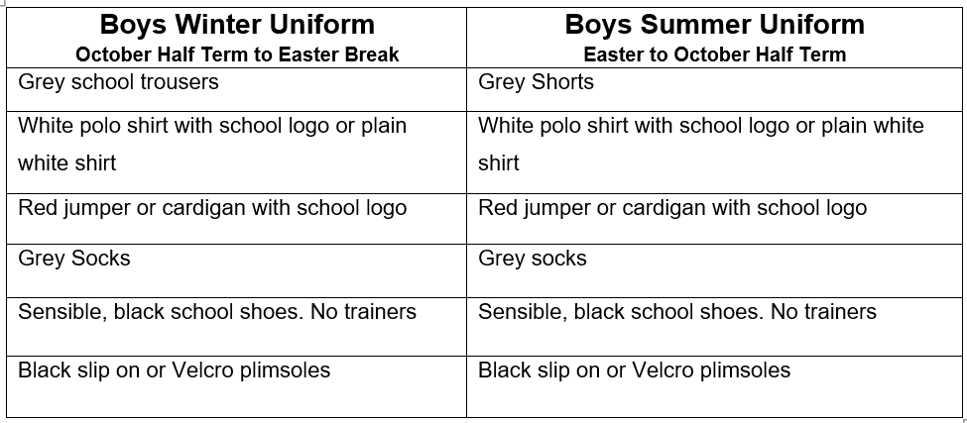
Boys' Uniform

Slide 8
PE Kit Reminders
PE Kit
Plain white, round neck, t-shirt (school logo optional)
Plain black shorts
Plain black/grey/dark blue joggers
School jumper
Trainers
PE Kit Expectations
It is better for PE Kits to be left in school every day.
It is our preference that PE kits are taken home and washed weekly.
Children will be able to do PE kit in their school uniform as long as their footwear is deemed safe for the activity being carried out.
If a PE kit isn’t in school then a quick conversation between the class teacher and parent will take place.
If a PE Kit is missing on a regular basis e.g. 3 weeks in a row then suitable consequences will be applied.
Year 4 have PE on Wednesday and Thursday
Notes:
Letter home

Slide 9
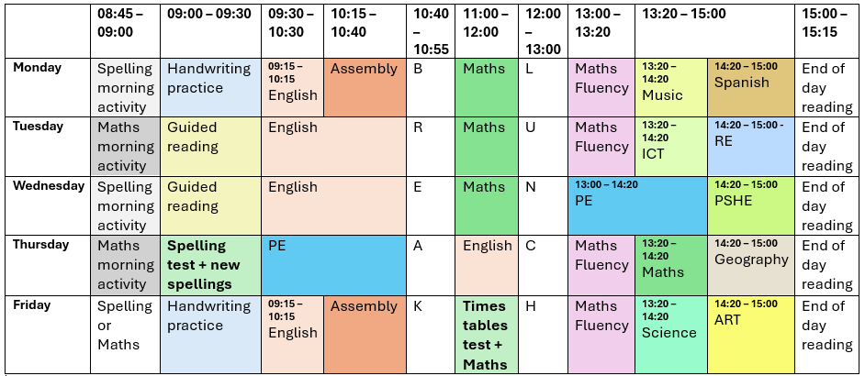
Class Timetable

Slide 10
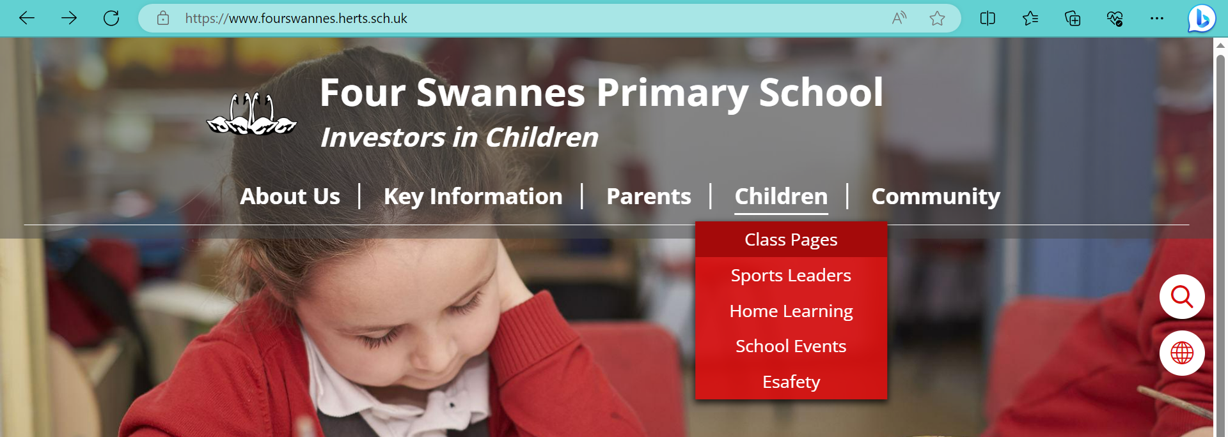
Links to website
Lots of class information can be found on the school website
We regularly update our class page with photos and videos of our work

Slide 11


Slide 12
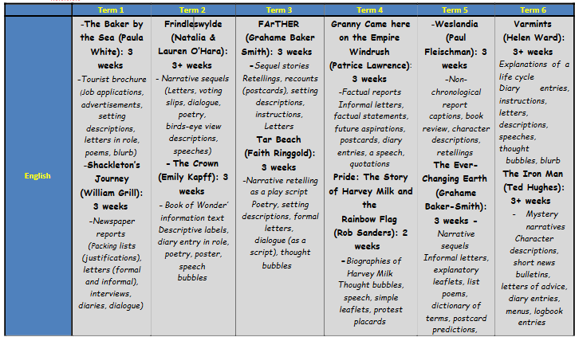
Year Curriculum Map

Slide 13
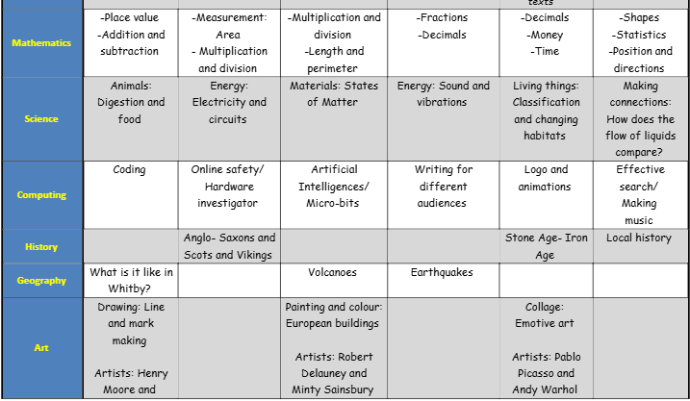
Year Curriculum Map

Slide 14
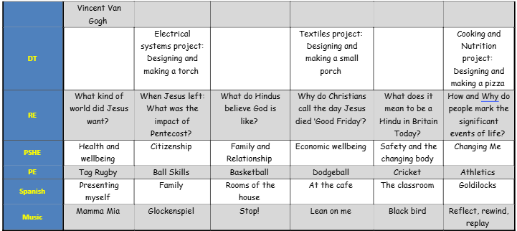
Year Curriculum Map

Slide 15
Communication Reminders
All urgent messages should be communicated to the School Office via telephone or in person on the day.
Feel free to pass a note or a letter to the office in the morning if needed.
All non-urgent messages that you wish to communicate via email should be directed to the School Office on admin@fourswannes.herts.sch.uk – in the subject heading you can state who you wish the email to be forwarded to.
To make an appointment with the class teacher, please speak to the school office or telephone the school office on 01992 763939.

Slide 16
Home-Learning
This Year we will continue to send home Home-Learning. Home-Learning will be sent home w/b
Sent home on a Friday to be returned the following Tuesday
Comprehension or Grammar activity
Maths fluency activity
Additionally, we expect your child to :
Practise times tables (test on Friday
Learn spellings (handed out on a Friday for a test the following Thursday
Read at least 3 x weekly with an adult
Your help in supporting your child with their home-learning is greatly appreciated.
It is important that the children try their best with the activity set. Please let us know if your child is finding it difficult.
Feedback on home-learning is verbal.

Slide 17
Reading at Home
Children will develop their reading skills through a variety of opportunities including independent reading, guided reading and shared reading.
How you can help at home:
  Children should be reading at home 3 times a week
  Talk about the book and ask questions.
As soon as a book is finished, please return it so it can be exchanged for a new one

Slide 18
Interventions that could be used to support your child
Through our ongoing formative assessments, decisions over the weeks ahead will be made as to best help your child to make progress in their learning.
Interventions may include :
Maths intervention groups
Early morning Writing/ Reading and Maths groups
Social group activities led by familiar and trusted adults
Additional fine-motor skills/ handwriting support
Pre-teaching and guided teaching opportunities
Power of two maths practice for basics
Protective Behaviours
Speech and Language support

Slide 19
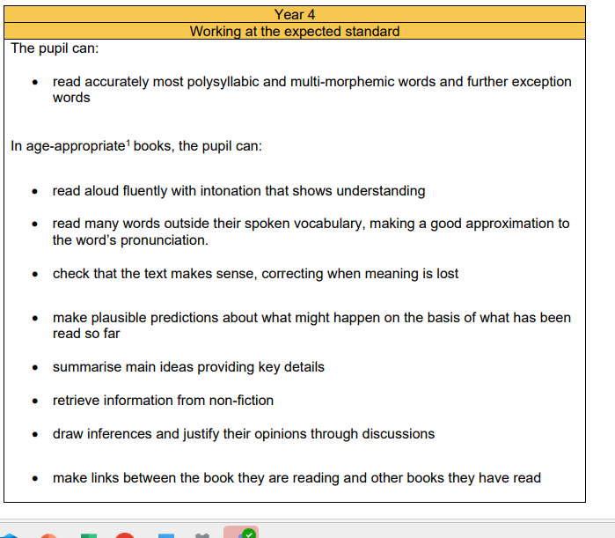
Year Key learning statements - Reading

Slide 20
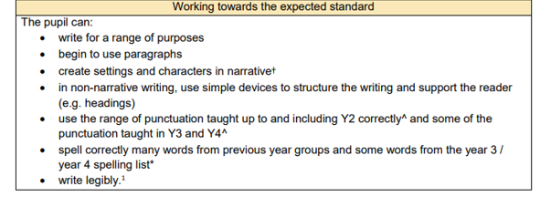
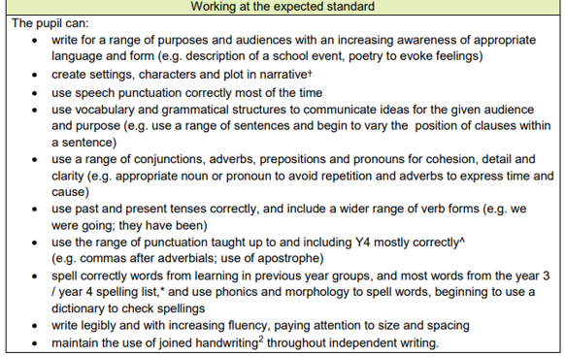
Year Key learning statements - Writing

Slide 21
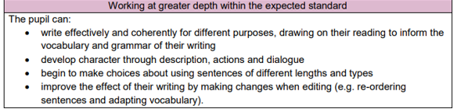
Year Key learning statements - Writing

Slide 22
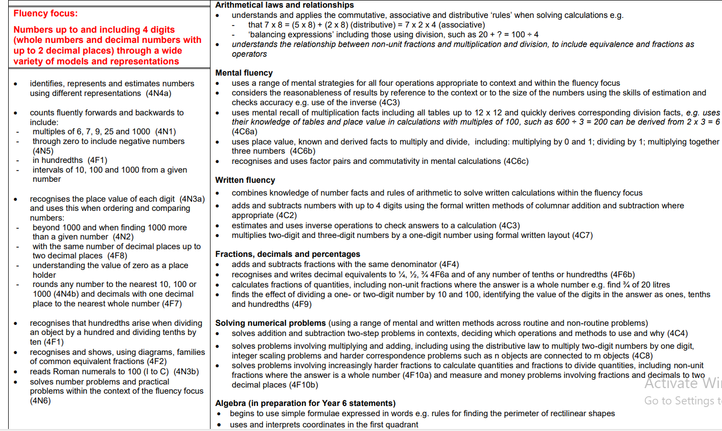
Year Key learning statements - Maths

Slide 23
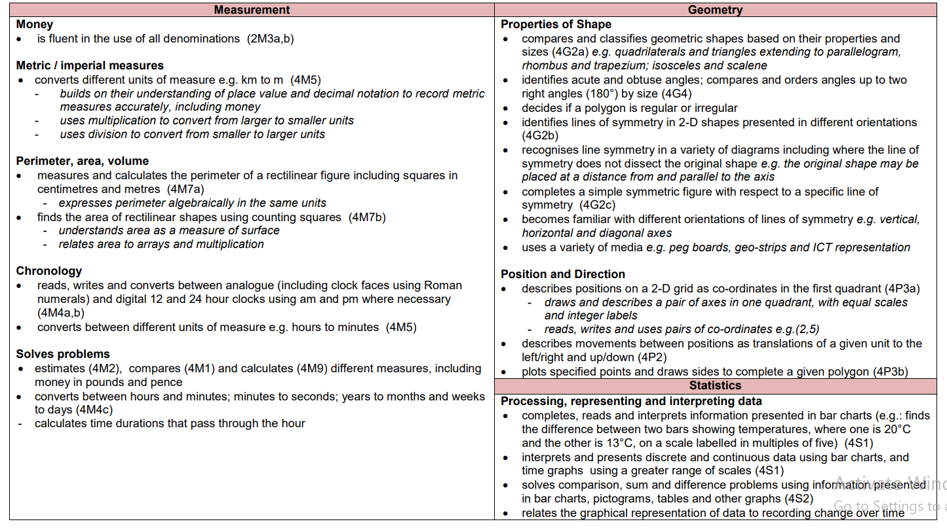
Year Key learning statements – Maths cont’d

Slide 24
Key Dates
Half Term: Monday 27th October 2025 to Friday 31st October 2025
Parent Consultations:
Occasional Day: Friday 5th December (school closed)
Last Day of term: Friday 19th of December 2025

Slide 25
Thank you for joining our Year Workshop
Any Questions?

